Slide 1
D-310 Unit 5: Crews
Notes:
BLM Veterans Train the Military | The Billings Veteran Crew … | Flickr

Slide 2
Objectives
Students will be able to:
Mobilize, reassign, and demobilize crews in a safe and cost-effective manner.
Describe procedures unique to specific types of crews.
Utilize supplemental forms associated with crew mobilization, reassignment, and demobilization.
Describe the interaction the crew dispatcher must have with other functional areas within the incident support organization.

Slide 3

Incident Position Standards Alignment
This unit aligns with the following Expanded Dispatch Support Dispatcher (EDSD) Incident Position Standards located at
https://www.nwcg.gov/positions/expanded-dispatch-support-dispatcher/standards-and-references.
EDSD responsibility alignment
Review and manage existing requests.
Receive and manage new requests.
Communicate and manage resources in preparation for reassignment or demobilization.
Perform effectively in each of the four functional areas.
Prepare for and implement demobilization.
Complete all administrative tasks and documentation in an accurate and timely manner.

Slide 4
Types of Crews
Type 1 (Interagency Hotshot Crew)
Type 2 Initial Attack (IA)
Type 2
Contract
Camp

Slide 5
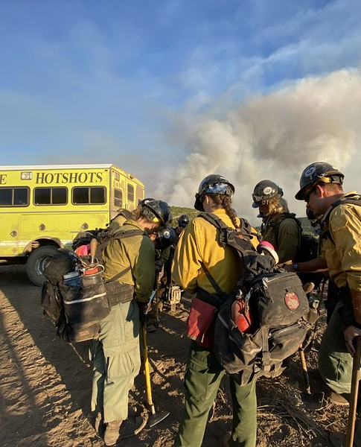
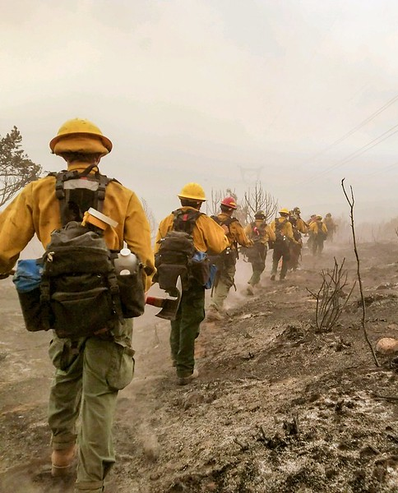
Type 1 Crews (1 of 3)
Notes:
Vale Hotshot Crew | Vale Interagency Hotshot Crew traveled t… | Flickr
2020 BLM Photo Contest: Crews | 2020 BLM Fire and Aviation P… | Flickr

Slide 6
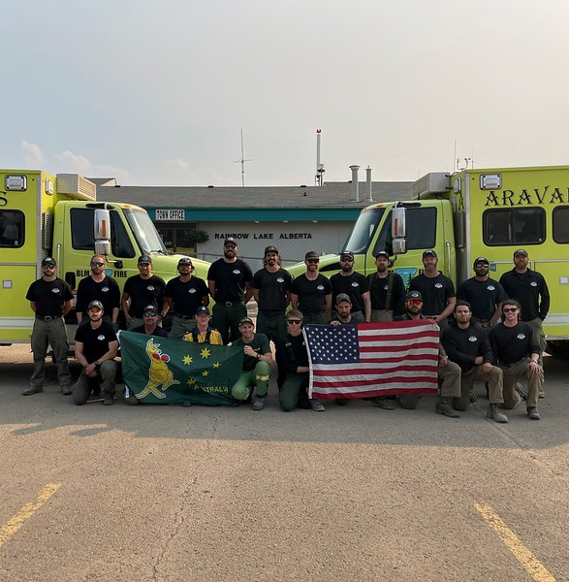
Type 1 Crews (2 of 3)
National resource.
80% of crew members have one or more seasons of fire experience.
4 agency-certified intermediate fallers (FAL2) and 50% of crew certified as basic faller (FAL3) or better.
Can mobilize within two hours during availability period.
18- to 25-person crew size.
Notes:
Veterans crew in Canada | 2023 BLM Fire Employee Photo Conte… | Flickr

Slide 7
Type 1 Crews (3 of 3)
5,300 lb. maximum weight
Fully equipped (tools & saws)
Self-sufficient
Have own transportation

Slide 8
Type 2 IA Crews (1 of 2)
Can be broken up into squads for IA.
Can be assembled as needed.
18- to 20-person crew size.
Leadership:
Crew Boss, Single Resource (CRWB)
Three Incident Commander Type 5 (ICT5)
60% of crew members have one or more seasons of fire experience.
3 agency-qualified sawyers.
5,300 lb. maximum weight.

Slide 9
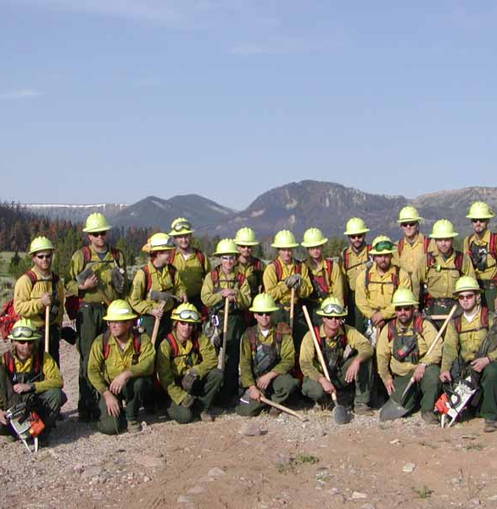
Type 2 IA Crews (2 of 2)
Meet national mandatory physical standards
Equipped with personal protective equipment (PPE)
May be self-sufficient

Slide 10
Type 2 Crews (1 of 2)
Assembled as needed.
18- to 20-person crew size.
20% of crew members have one or more seasons of fire experience.
No agency-qualified sawyers required.
5,300 lb. maximum weight.
May not be self-sufficient or fully equipped (tools & saws).

Slide 11
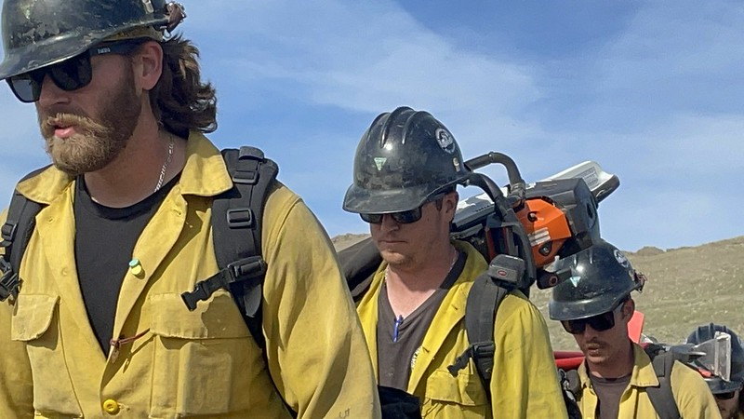
Type 2 Crews (2 of 2)
Meet national physical fitness standards
Equipped with PPE
Notes:
Ruby Mountain Hotshots Training | The Ruby Mountain Hotshots… | Flickr

Slide 12
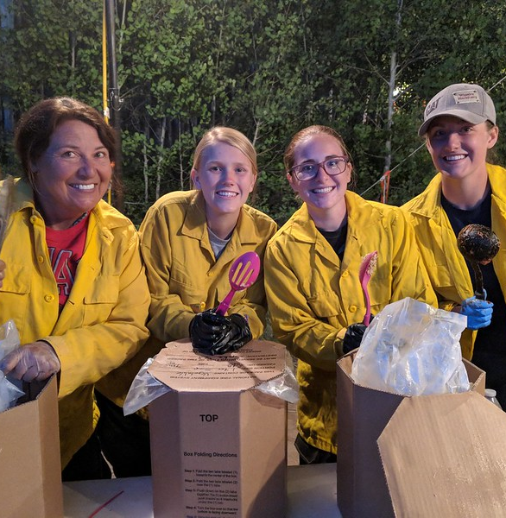
Camp Crews (1 of 2)
Support daily operations, assemble, and disassemble camp.
Assembled as needed
10 person or fewer crew size (including crew leader)
May be required to meet fitness standards
Notes:
Camp Crew Ready to Serve Dinner | The Camp Crew at the Trail… | Flickr

Slide 13
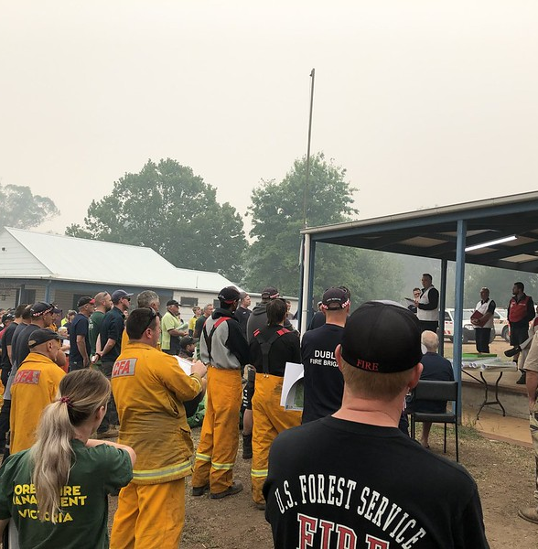
Camp Crews (2 of 2)
PPE supplied by home unit or incident
Not self-sufficient, not equipped
Transportation needed
Follows the Conditions of Hire and Rules of Conduct set by sponsoring agency
Notes:
2020 BLM Photo Contest: Fire Camp | 2020 BLM Photo Contest C… | Flickr

Slide 14
Inmate and Kitchen Crews
Inmate crews
Used within the state, approval needed to cross state lines.
Consult the local area for procedures and guidelines.
Kitchen crews
Assist with mobile kitchen functions.
Consult the local area for procedures and guidelines.

Slide 15
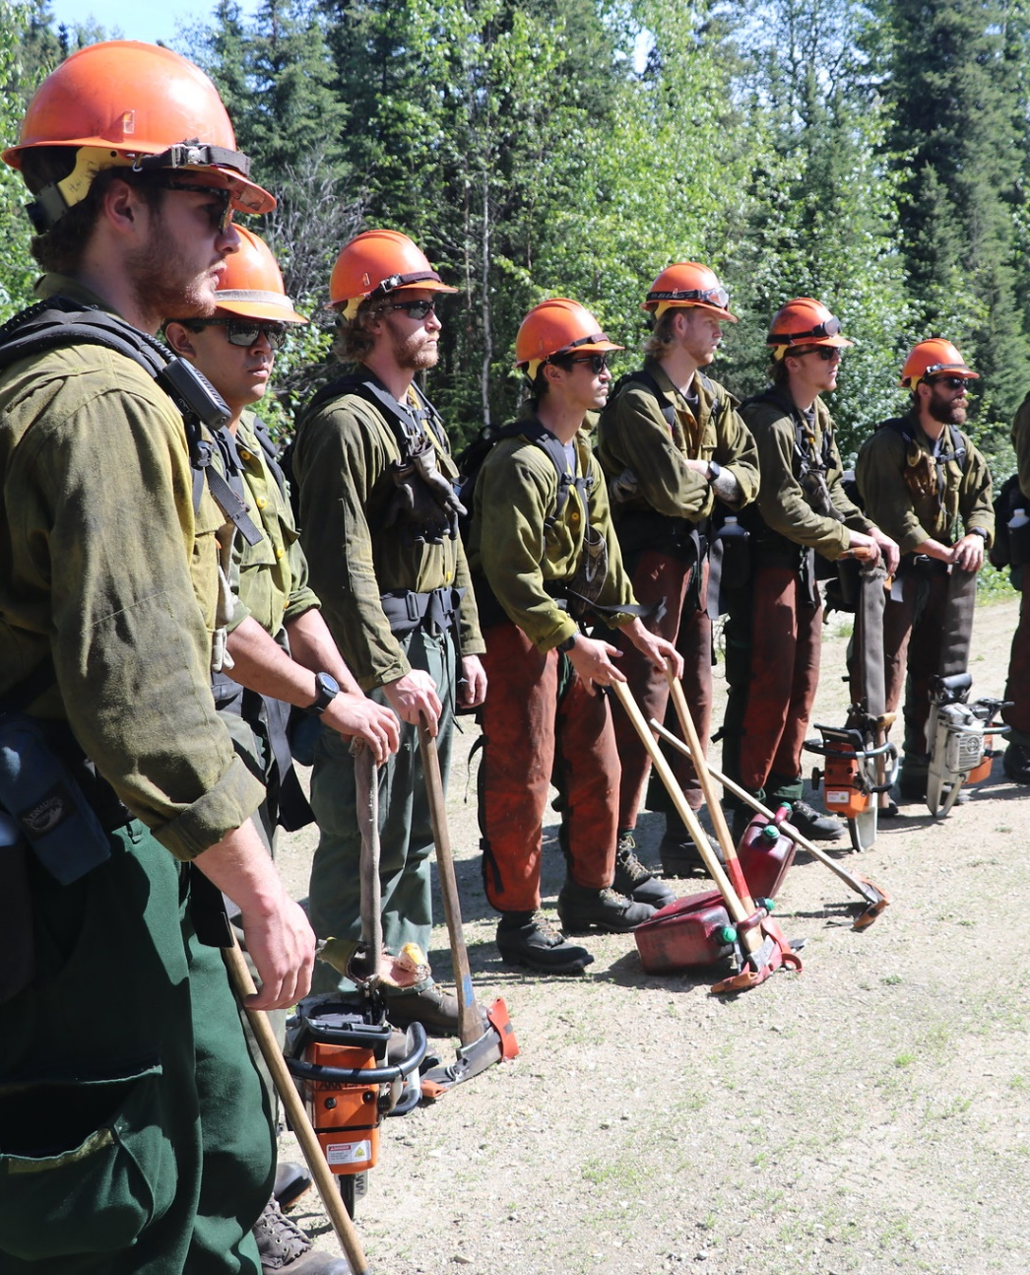
Contract Crews
Type 2 IA or Type 2.
Come with radios, saws, tools, transportation, PPE, supervision, etc.
Require inspection prior to going on fireline.
Must comply with work/rest, assignment length guidelines.
Mobilized using current local procedures.
Type 2 contract crews are ordered from the NICC.
Notes:
Alaska crew conducts fuels reduction project 7 | The Alaska … | Flickr

Slide 16
Crew Configuration
Each crew is assigned an individual crew request number.
Crews with configuration:
Are rostered in the Interagency Resource Ordering Capability (IROC) system.
Receive a request number for each crew member.
Crews without configuration (single resource).
Strike teams:
Are generally not utilized nationally.
Consist of two or more like crews and a leader.

Slide 17







Crew Ordering Information
Type of crew
Tool requirements
Meals
Timeframes
Sources
Transportation considerations
Unusual needs for assignment

Slide 18

Meals
Questions and concerns to consider when feeding crews.
Are meals needed at this time?
When was the crew’s last meal?
When will their next meal be?
Should sack lunches be provided?
Who does the EDSD work with to support the crews?
Notes:
Caterers Provide Meals for Firefighters | Caterers set up at… | Flickr

Slide 19
Timeframes
The incident will set a date and time needed.
If this timeframe cannot be met, contact the incident and reevaluate timeframes, crew needs, etc.
Consider the following:
Availability
Travel time
Meals
Work/rest guidelines
Date needed
Time to organize

Slide 20
Sources
Administered locally – federal, cooperators (e.g., agencies served by your IA dispatch center), contract.
Available through neighbor or mutual aid agreements.
Available for reassignment from another incident.

Slide 21
Transportation Considerations
Safety
Cost-effectiveness
Timeframes
Mission objectives
Type of transportation

Slide 22
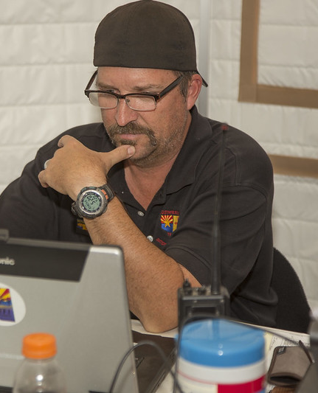
Unusual Needs for Assignment
Any unusual needs for the crew assignment should be part of the initial crew request.
Notes:
Communications Are Essential For Firefighters | Communicatio… | Flickr

Slide 23
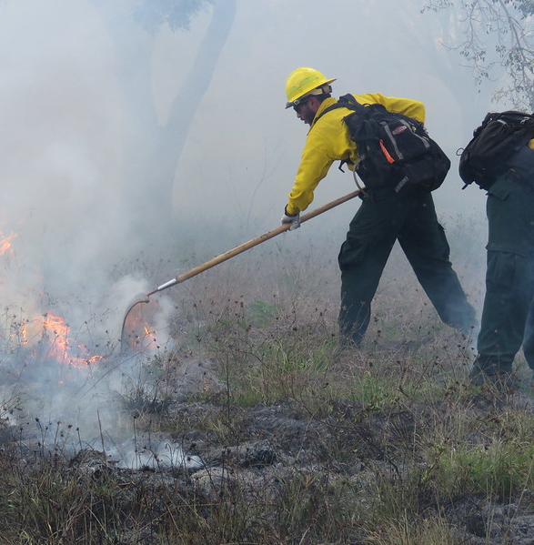
Crew Representative (CREP)
Provides support to crews that are sent from one geographic area to another.
Responsible for administrative duties
Can assist CRWB with duties
Notes:
Monitoring a Prescribed Fire | Firefighters monitor the edge… | Flickr

Slide 24

Interagency Resource Representative (IARR)
Mobilized when a geographic area or state has committed four or more agency crews.
Liaison between resources and IMT or incident agency.
Can assist with administrative tasks including emergency releases and demobilization.
Notes:
North Complex, Tallac IHC | Tallac hotshot on division TT of… | Flickr

Slide 25
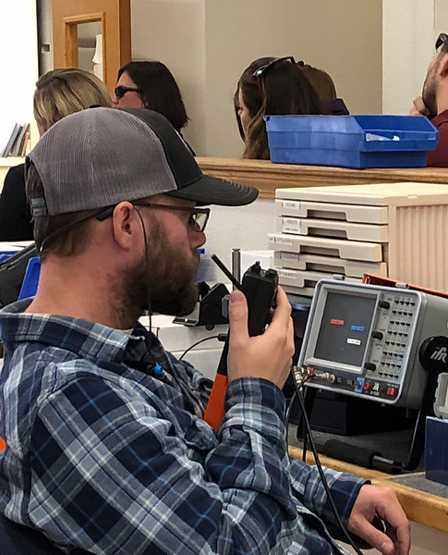
Crew Dispatcher Coordination with Other Dispatchers
Supervisory dispatcher
Equipment desk
Supply desk
Overhead desk
Aircraft Dispatcher (ACDP)
Notes:
On the campus of the National Interagency Fire Center. | Flickr

Slide 26
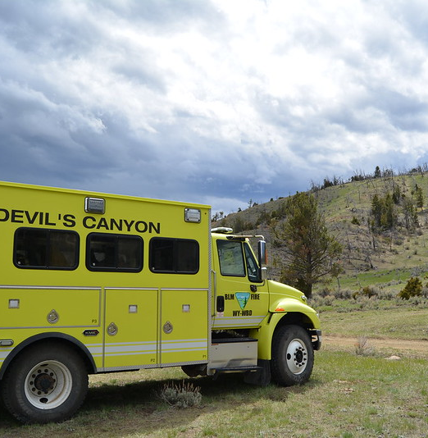
Reassignment/Demobilization (1 of 2)
Resources have transportation.
Things to consider
Distance and time en route
Duty limitations of drivers
Number of drivers available or needed
Meals and lodging
Rest overnight (RON) location
Notes:
Critical 80 Training | The Devil's Canyon Veterans crew part… | Flickr

Slide 27
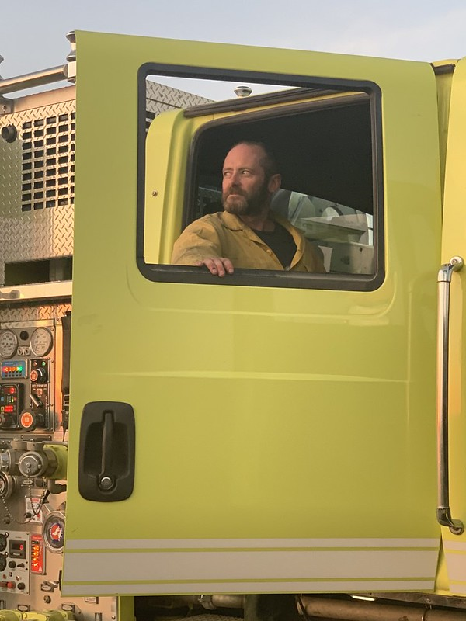
Reassignment/Demobilization (2 of 2)
Resources need transportation.
Things to consider
What is cost-effective?
Distance and time en route
Duty limitations of drivers
Meals and lodging
Weather
RON location
Notes:
2021 BLM Fire Employee Photo Contest Category: Fire Person… | Flickr

Slide 28
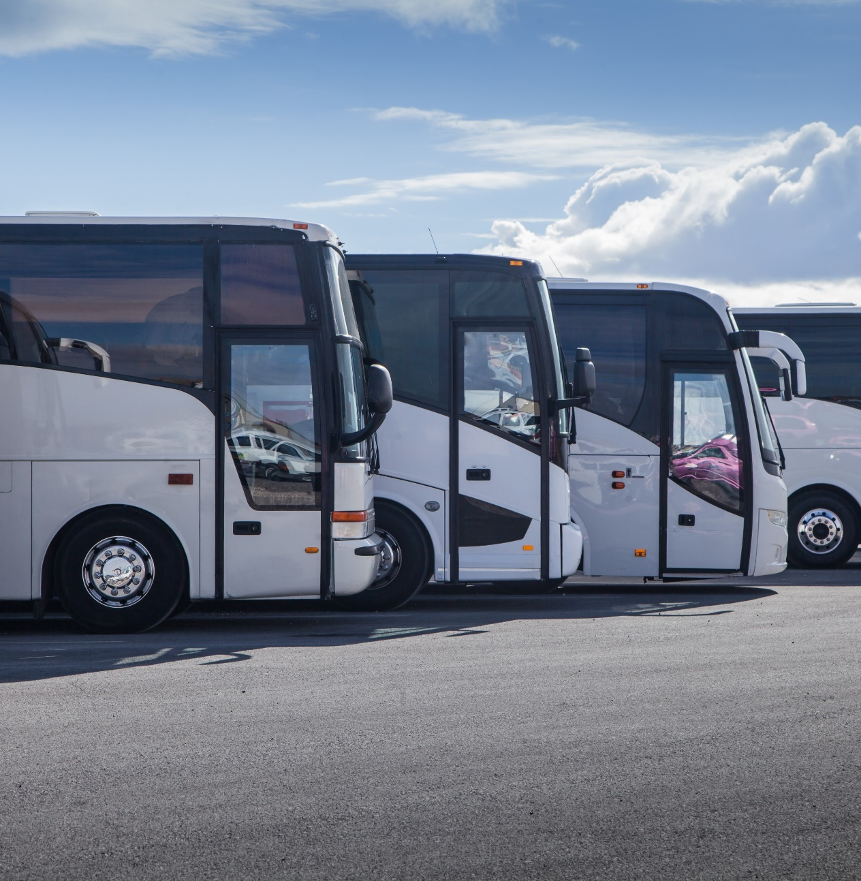
Ground Transportation
Types:
Highway coach
School bus
Crew carriers
Vans
Rentals
Is a chase vehicle necessary for tools?
Place and order with the equipment dispatcher.
Notes:
Tourist Buses On Parking Stock Photo 477310891 | Shutterstock

Slide 29
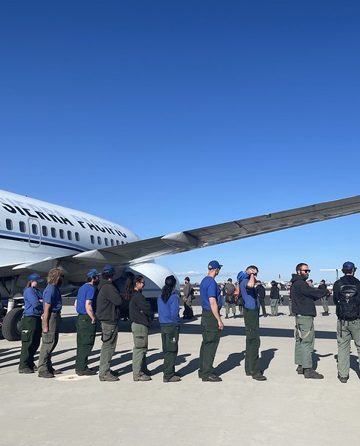
Air Transportation (1 of 2)
Is commercial air transportation available?
If commercial air is not available
May require an Aircraft Flight Request/Flight Schedule form.
Large transport ordered from National Interagency Coordination Center (NICC) via established channels.
Coordinate with the supervisory dispatcher.
Order via ACDP.
Group crews by demobilization points.

Slide 30
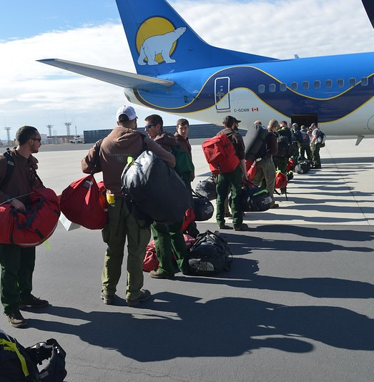
Air Transportation (2 of 2)
Information needed
Departure and destination points
Time en route
Ready-to-load (RTL) time
Pickup point at jetport
Accurate count/weight of passengers
Meal needs
Notes:
Firefighters Head to Canada to the Fort McMurry Fire | Flickr

Slide 31
Emergency/Disciplinary Releases
Emergency releases can warrant immediate action for demobilization.
If an individual is released, another person may travel as a companion.
An IARR can assist with emergency notifications and other arrangements.

Slide 32
Emergency Releases
Emergency release situations
Family emergencies
Job-related emergencies
Legal transactions
Childcare
Educational commitments
Military obligations
Injuries and health problems
Documentation of all emergency releases is critical.

Slide 33
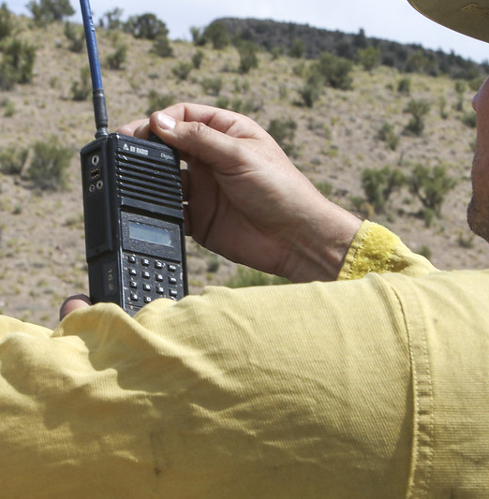
Sensitive Messages
Ensure a person learns the details of a personal crisis in a controlled manner.
Notes:
MAY 15 Using radio and mobile phone | KINGMAN, AZ - MAY 15: … | Flickr

Slide 34
Disciplinary Releases
Disciplinary release situations
Drugs and/or alcohol
Harassment
Destruction of property
Fighting
Insubordination
Documentation of all disciplinary releases is critical.

Slide 35
Summary
There are four types of crews:
Type 1 (Hotshots), Type 2 IA, Type 2, Camp
Crew ordering information:
Type of crew, tool requirements, meals, timeframes, sources, transportation considerations, unusual needs for assignment
Miscellaneous overhead positions related to crews:
CREP, IARR
Crew dispatchers coordinate with supervisory dispatchers, equipment/supply/overhead desks, ACDP, Ramp Manager (RAMP), Staging Area Manager (STAM), and the miscellaneous overhead positions listed previously.
Consider whether resources have or need transportation when demobilizing.
Documenting emergency and disciplinary releases is critical.

